Slide 1

APPLICATION SECURITY
(The Java Native Interface)
Speaker: Dimitrios Valsamaras | @Ch0pin
https://www.linkedin.com/in/valsamaras/

Slide 2

The Java Native Interface
The Java Native Interface
Locating native libs
Dynamic / Static linking
Resolving Native Methods
Tracking down Native Methods in Ghidra
Using JNITrace

Slide 3
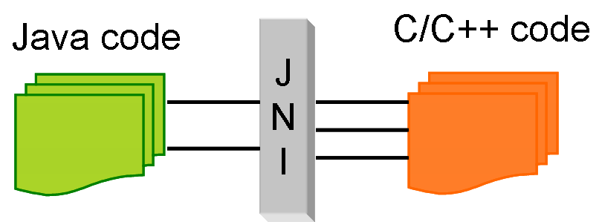
The Java Native Interface
The Java Native Interface (JNI) provides a mechanism (bridge) by which a program written in Java can call routines or make use of services written in native code.
Programmers use the JNI to write Java native methods to handle those situations when an application cannot be written entirely in Java:
Examples:
The standard Java class library does not support the platform-dependent features needed by the application.
You already have a library written in another language, and wish to make it accessible to Java code through the JNI.
You want to implement a small portion of time-critical code in a lower-level language such as assembly.

Slide 4
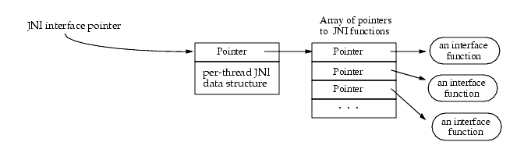
The Java Native Interface
Native code accesses Java VM features by calling JNI functions
JNI functions are available through an interface pointer
An interface pointer is a pointer to a pointer of an array of pointers that point to interface functions

Slide 5
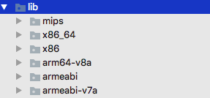
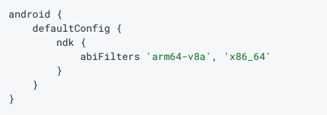
Locating native libs
After compilation native libraries are stored in various folders based on the ABI. Both the Play Store and Package Manager expect to find NDK-generated libraries on file paths inside the APK matching the pattern /lib/<abi>/lib<name>.so
For the libfoo.so whis would be:
/lib/armeabi/libfoo.so
/lib/armeabi-v7a/libfoo.so
/lib/arm64-v8a/libfoo.so
/lib/x86/libfoo.so
/lib/x86_64/libfoo.so

Slide 6

Loading Native Code
Native methods are loaded with the System.loadLibrary or the System.load method:
Loading “libfoo.so”
System.loadLibrary(“foo”)
The system follows a standard, but platform-specific, approach to convert the library name to a native library name. For the Android OS the expected path is /data/app/<app-name>/lib/<arch>/libfoo.so
libfoo.so
Example:
System.load(“/full/path/to/libfoo.so”)
/data/data/com.foo.bar/files/libfoo.so
The function expects the full name of the path

Slide 7
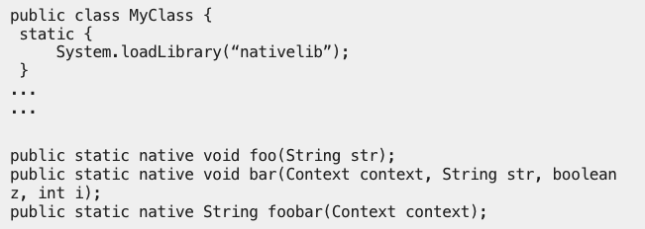
Declaring Native functions
foobar implementation will be in the libnativelib.so

Slide 8
Resolving Native Methods
Entries are resolved based on their names:
Dynamic
Static
The prefix Java_
A mangled fully-qualified class name
An underscore (“_”) separator
A mangled method name
For overloaded native methods, two underscores (“__”) followed by the mangled argument signature

Slide 9
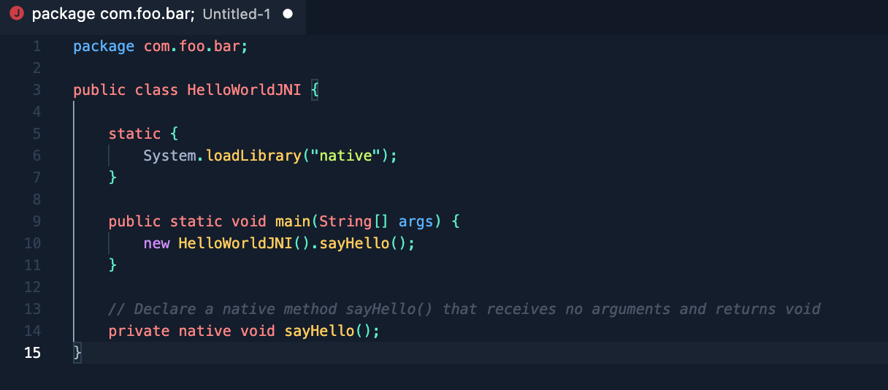
Resolving Native Methods
Dynamic
com.foo.bar.HelloWorldJNI.sayHello
Resolves to:
Java_com_foo_bar_HelloWorldJNI_sayHello

Slide 10
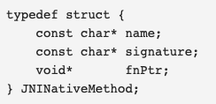
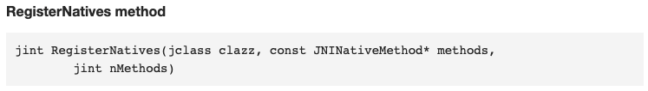
Resolving Native Methods
The programmer can also call the JNI function RegisterNatives() to register the native methods associated with a class. The RegisterNatives() function is particularly useful with statically linked functions:
Dynamic
Static

Slide 11
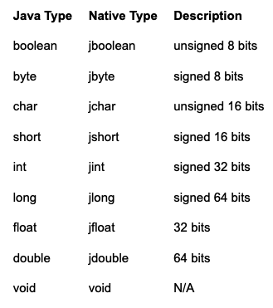
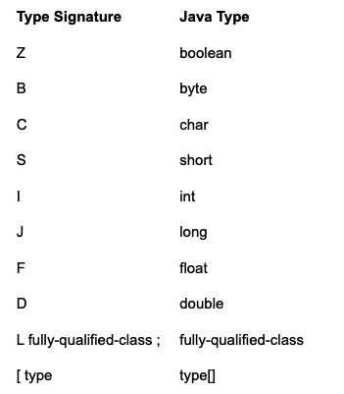
Method SIGNATURES
Java method:
long f (int n, String s, int[] arr);
Type signature
(ILjava/lang/String[I)J
(int n, String s, int[] arr) long
Primitive Types and Native Equivalents

Slide 12
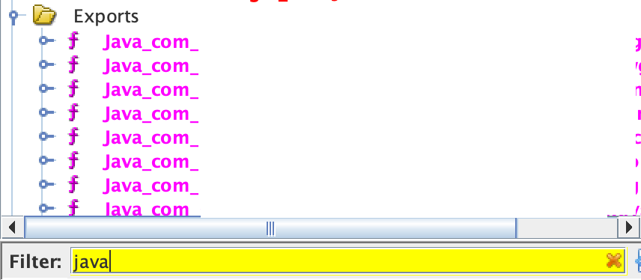


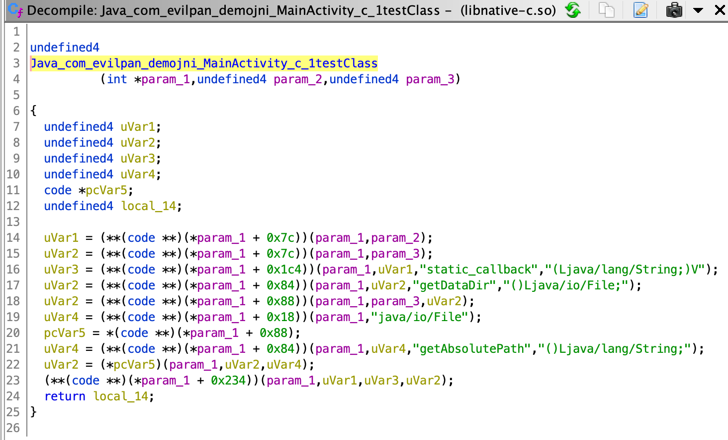
Tracking down Native Methods
Dynamic Linking
Need to Re-type !

Slide 13
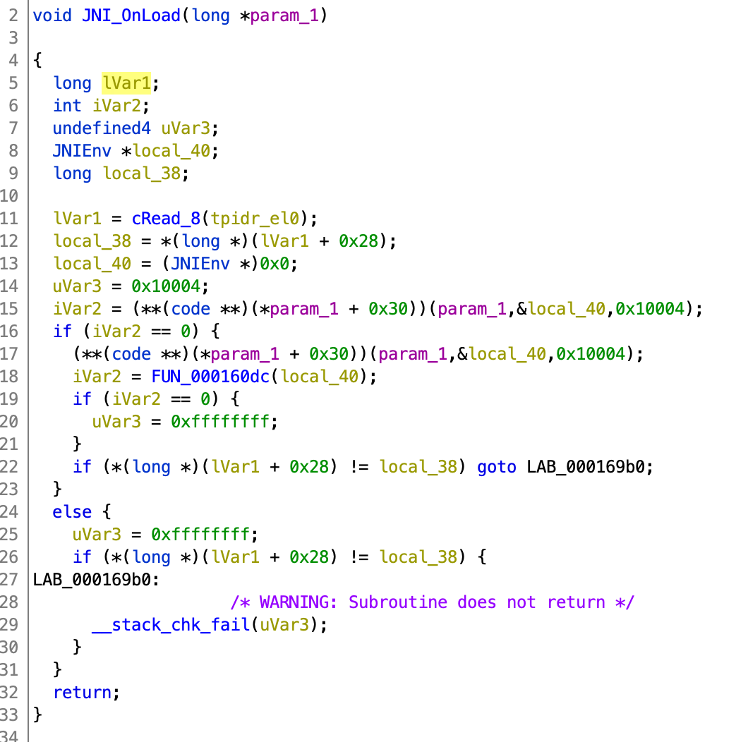
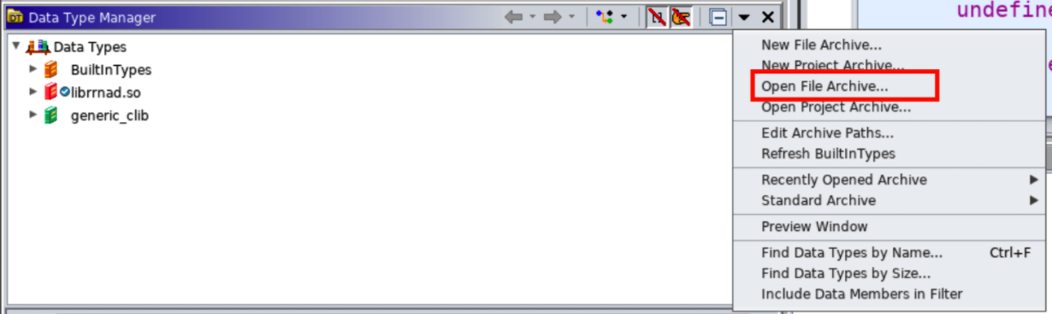
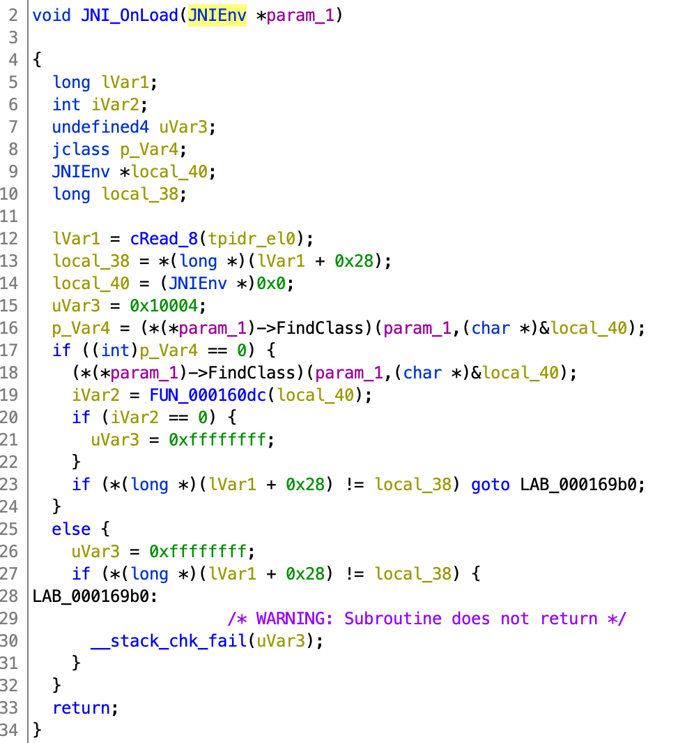
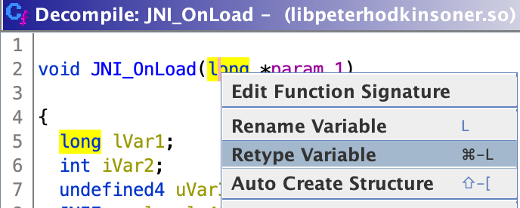
Tracking down Native Methods
Retype
Import jni_all.gdt to Ghidra
2. Retype the pointer to JNIEnv* to resolve the actual function names

Slide 14
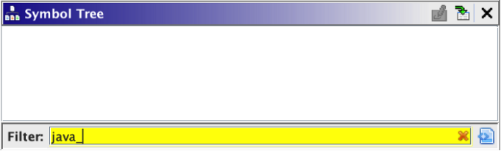
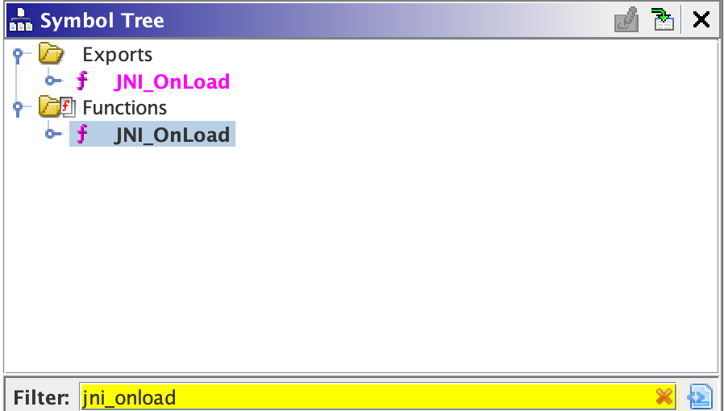
Tracking down Native Methods
Static Linking
Track down the JNI_OnLoad

Slide 15
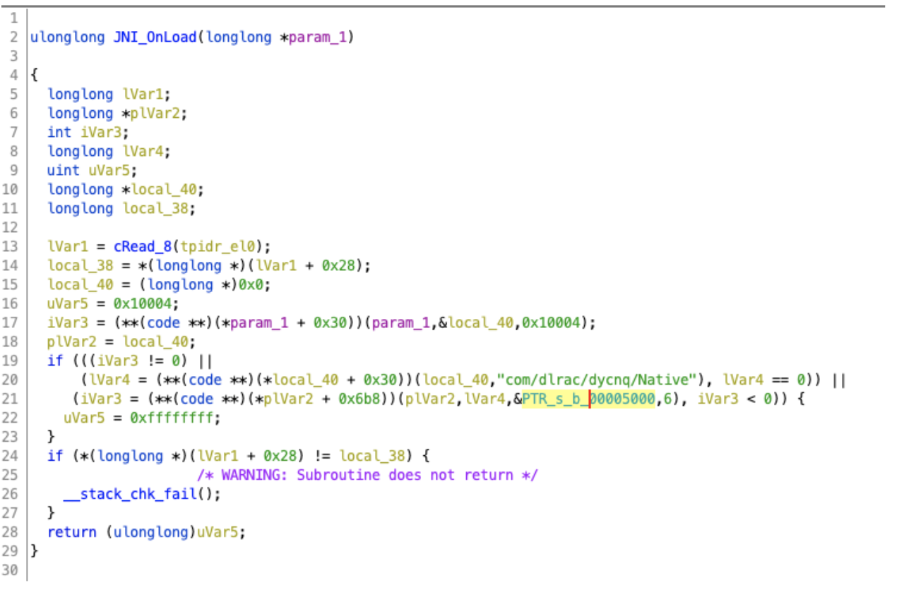
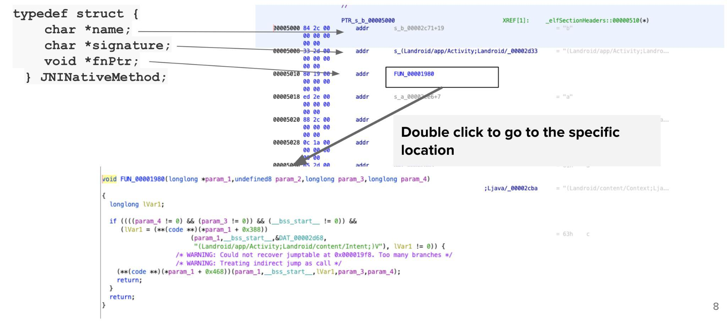
Tracking down Native Methods

Slide 16
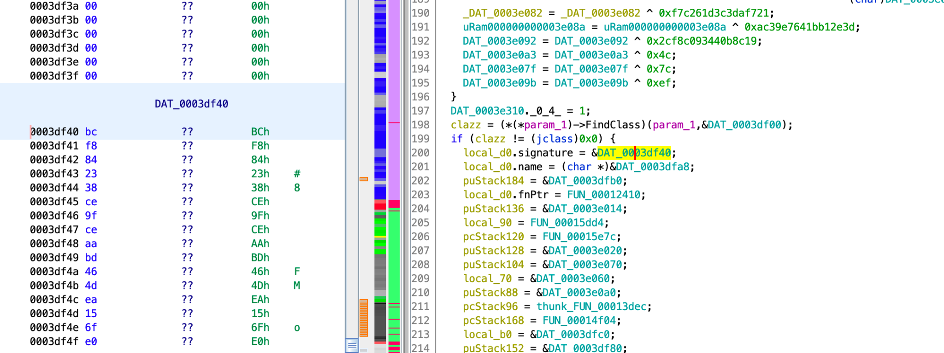
Tracking down Native Methods
Sometimes it is hard to trace ...

Slide 17
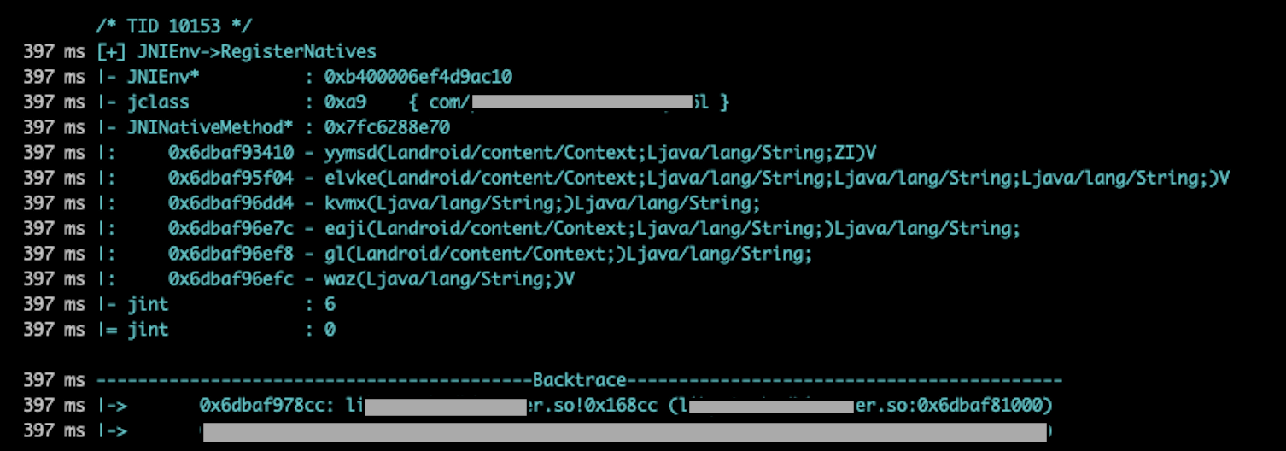
JNITrace to the Rescue
Usage
$jnitrace -l <libname> <package name>

Slide 18
JNITrace to the Rescue
Memory Address
of the RegisterNatives
0x6dbaf93410–0x6dbaf81000 = 12410
Memory Address where the library is loaded
Memory Address of the function
Actual offset

Slide 19
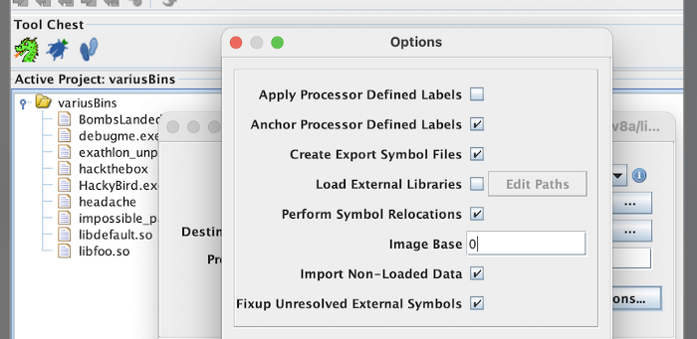
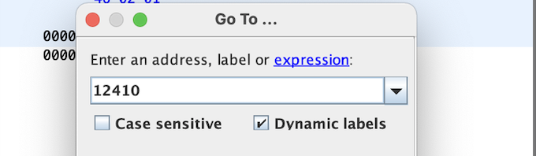
JNITrace to the Rescue
Set the Image Base to 0
Type the address from the previous step
Import the library

Slide 20
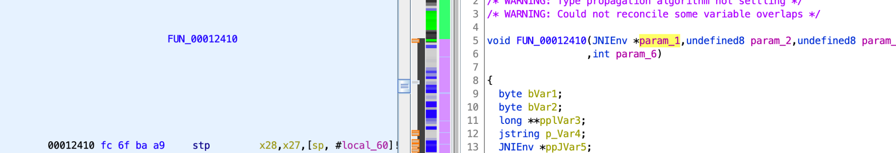
JNITrace to the Rescue
Native: yymsd(Landroid/content/Context;Ljava/lang/String;ZI)V
Java: public static native void yymsd(Context context, String str, boolean z, int i);
Is implemented by the function FUN_00012410

Slide 21
References
https://github.com/evilpan/jni_helper
https://valsamaras.medium.com/tracing-jni-functions-75b04bee7c58
https://docs.oracle.com/javase/7/docs/technotes/guides/jni/spec/jniTOC.html
https://developer.android.com/ndk/guides
https://www.ragingrock.com/AndroidAppRE/

